Slide 1
Machine Learning Techniques for 3D Data Analysis
Jifang Duan
Supervisor: David R. Selviah
Second Supervisor: Yiannis Andreopoulos
11/06/2019

Slide 2
Major Contributions
Major new work in my research
3D force touch analysis on piezoelectric-based interactive displays
Propose a nested structured deep neural network for user-oriented 3D force touch analysis – new application
Sphere recognition for 3D registration
Propose a novel Range-based recognition method
3D object segmentation and recognition
Propose a novel plane detection algorithm
Propose two novel parallel-structured 3D convolutional neural network architectures for object recognition

Slide 3
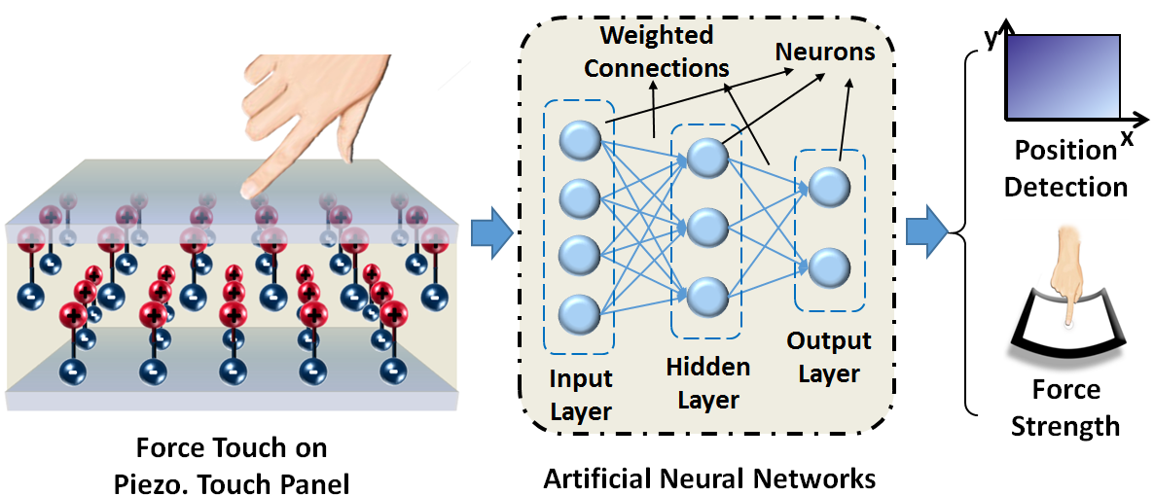
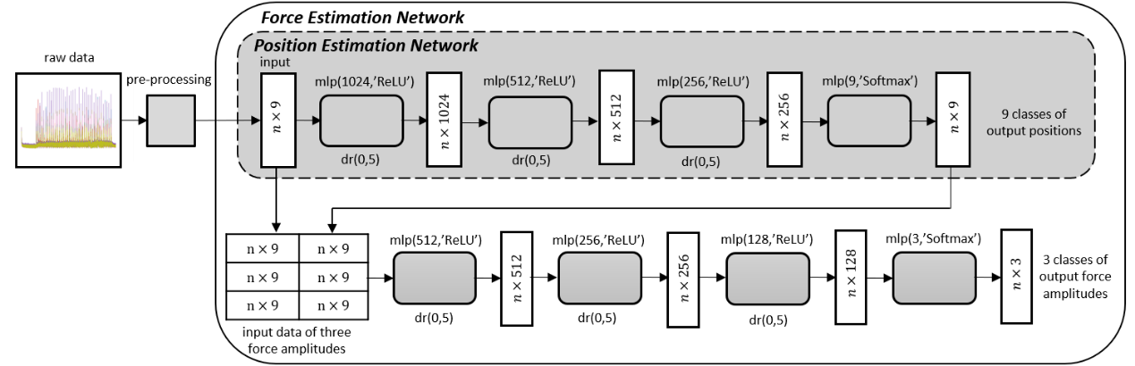
3D Force Touch Analysis
Aim
Using a nested deep neural network to estimate both touch position and force level of customised touch behaviour on piezoelectric-based touch panel

Slide 4
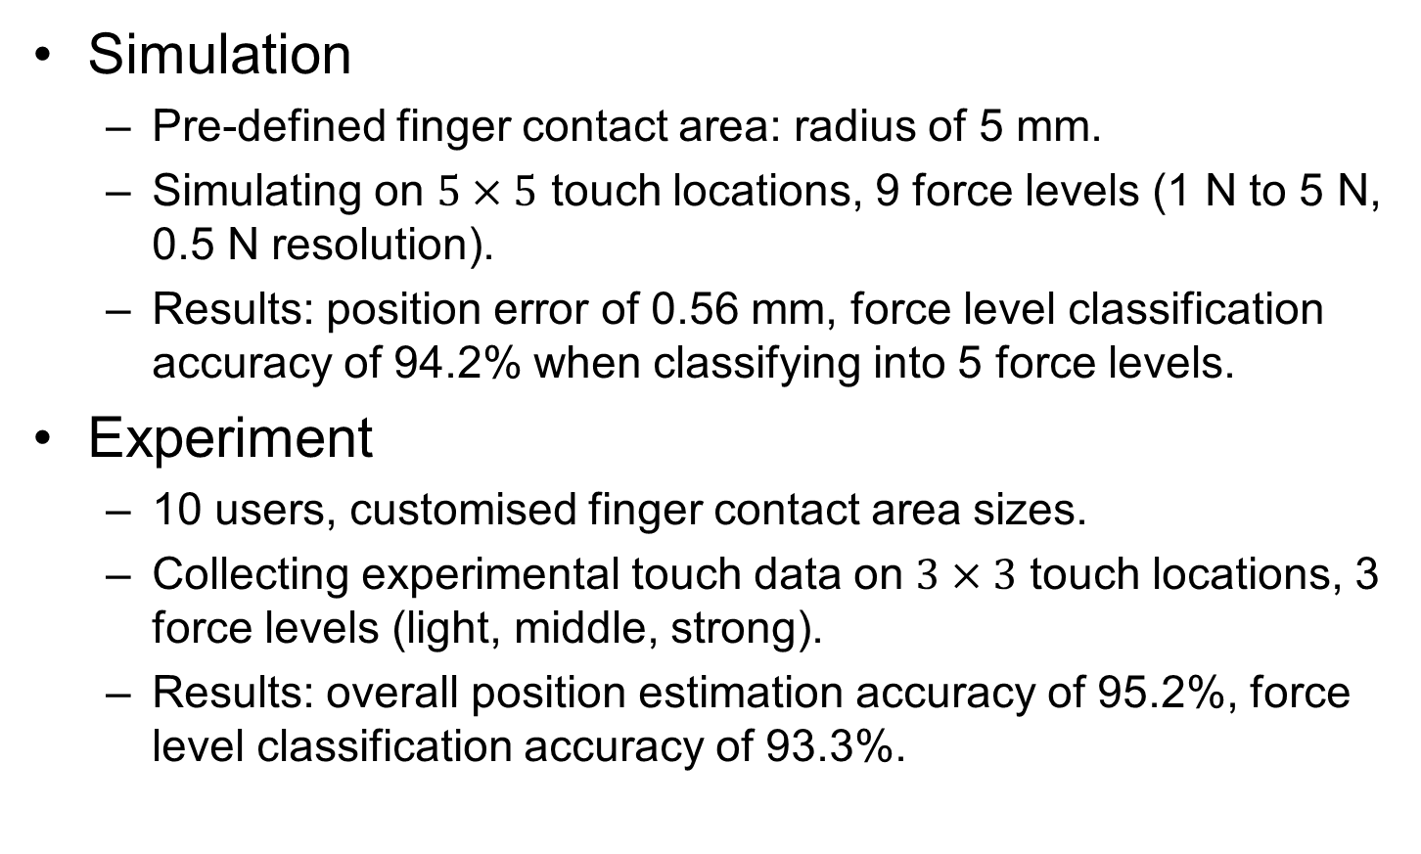
3D Force Touch Analysis
Simulation
Pre-defined finger contact area: radius of 5 mm.
Simulating on $5×5$ touch locations, 9 force levels (1 N to 5 N, 0.5 N resolution).
Results: position error of 0.56 mm, force level classification accuracy of 94.2% when classifying into 5 force levels.
Experiment
10 users, customised finger contact area sizes.
Collecting experimental touch data on $3×3$ touch locations, 3 force levels (light, middle, strong).
Results: overall position estimation accuracy of 95.2%, force level classification accuracy of 93.3%.

Slide 5
Sphere Recognition
Aim
Using 3D point cloud data to recognise spheres that can be used for 3D registration
Time efficient, can be applied to large datasets
Current solutions to this problem:
Hough Transform: Poor time efficiency, large memory consumption
RANSAC: Time-consuming when dealing with problems of small inlier ratio (in our case the inlier only accounts for less than 0.03% of the whole scanning data)

Slide 6
Sphere Recognition
Our novel approach – the Range method
Recognise spheres from a single scan
Using the ranges of two sphere features:
surface curvature
surface roughness
Supervised learning
An iterative method, constantly remove non-spherical points and updating the above two features of the remaining data points

Slide 7
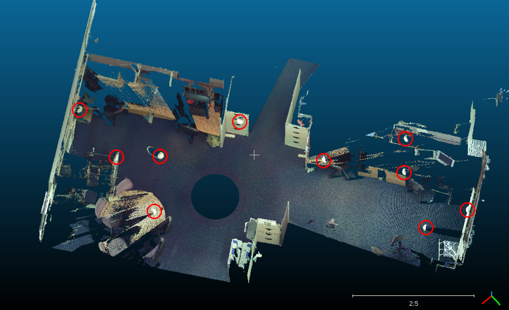
Sphere Recognition
Spheres in the scene are encircled by red circles

Slide 8
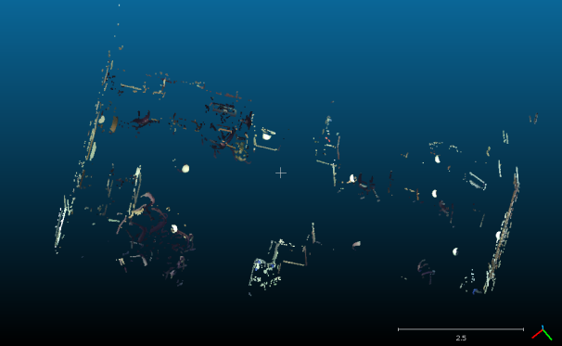
Sphere Recognition
After one iteration

Slide 9
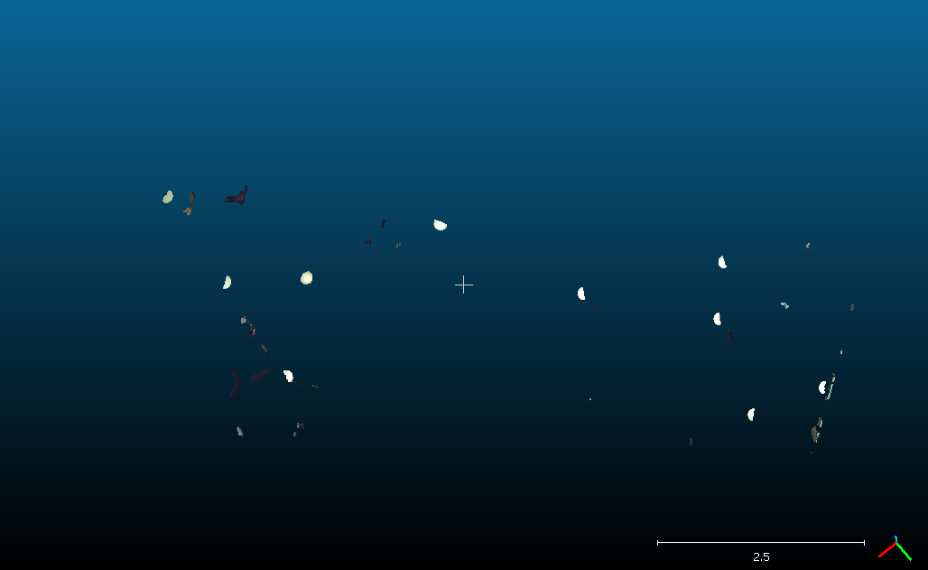
Sphere Recognition
After two iterations

Slide 10
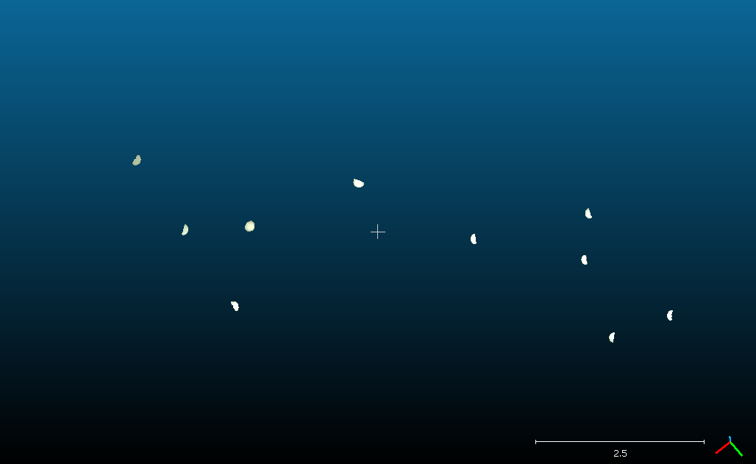
Sphere Recognition
Recognised spheres (the program stops automatically, around 6 iterations)

Slide 11
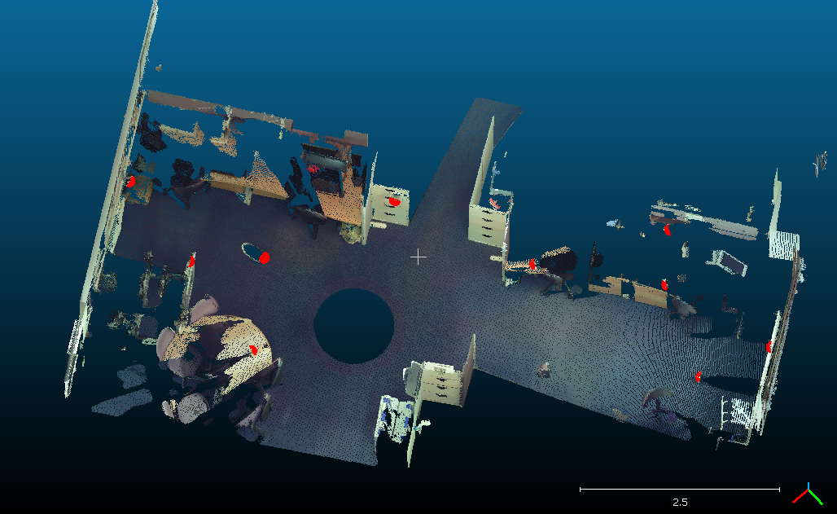
Sphere Recognition
Recognised spheres marked in red

Slide 12

Object segmentation and recognition
Aim
Automate the whole process of object segmentation and recognition, make each step feasible in a short time frame using ordinary performance laptops with limited memory and computing resources.
Flowchart of our approach

Slide 13
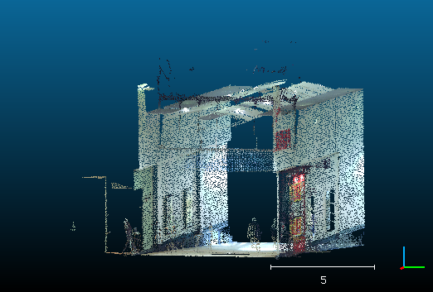
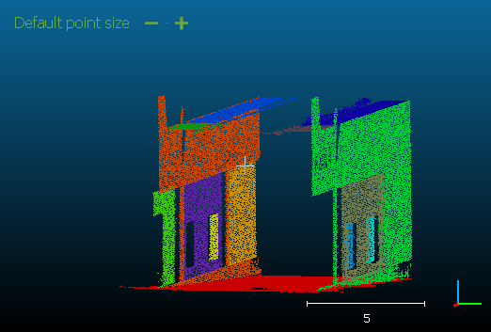
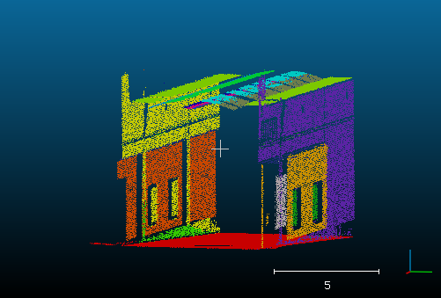
Part 1: Plane Detection and Background Subtraction
Two commonly used plane detection approaches
Region growing
Able to include boundary points to recognised planes
Slow
RANSAC
Fails to recognise boundary points
Fast
Original data Region growing RANSAC

Slide 14
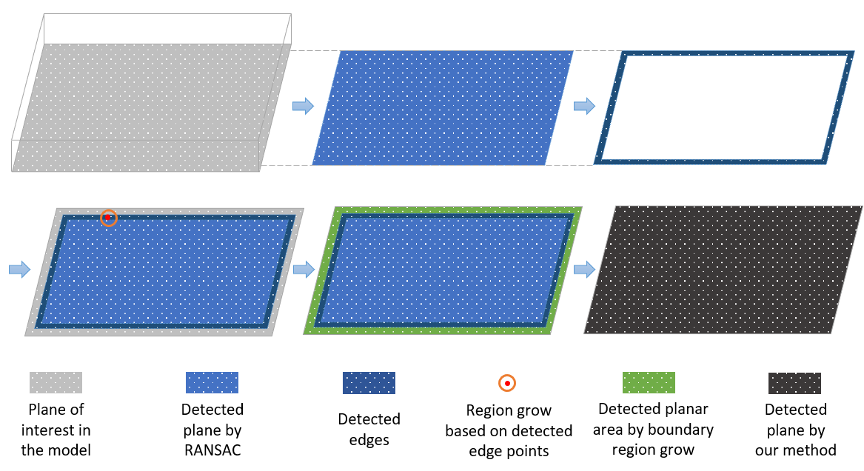
Part 1: Plane Detection and Background Subtraction
Our approach
Efficient
Able to include edge points to the recognised planes

Slide 15
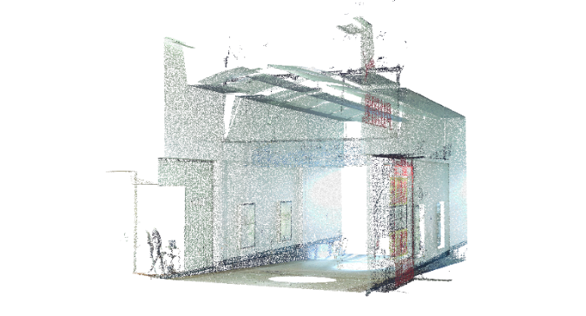
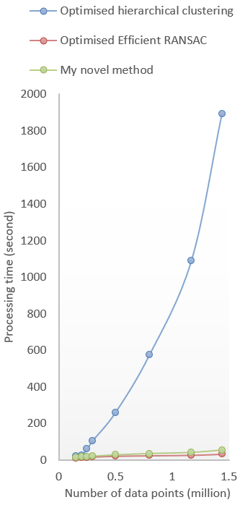
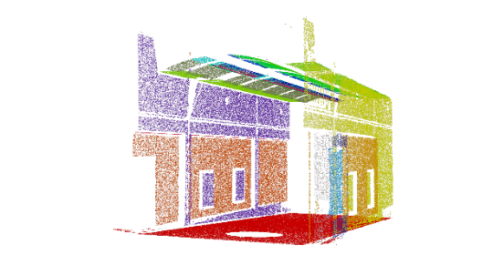
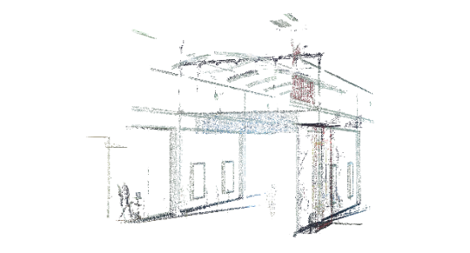
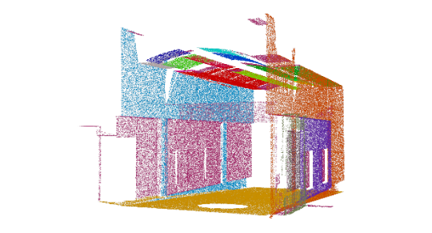
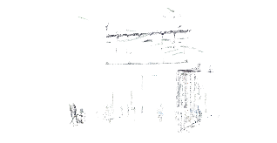
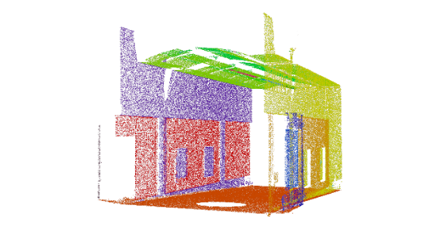
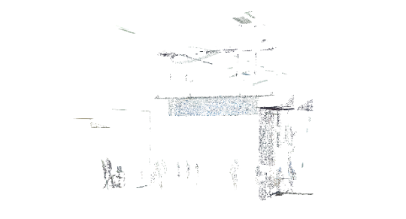
Part 1: Plane Detection and Background Subtraction
Original
Efficient RANSAC
Hierarchical clustering
My novel method

Slide 16
Part 2: Object Segmentation
Objects are segmented based on spatial intervals after background subtraction
Voxel grid based region growing
Similar to the original region growing based method, use a voxel grid rather than a point as a basic unit
Grow regions by constantly adding neighbouring grids that have points inside to the current cluster
Each voxel grid has 26 immediate neighbouring grids

Slide 17
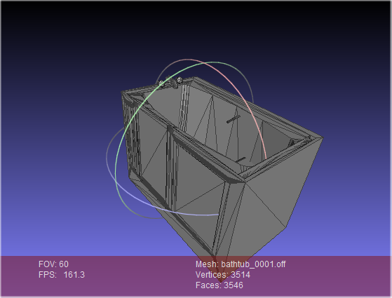
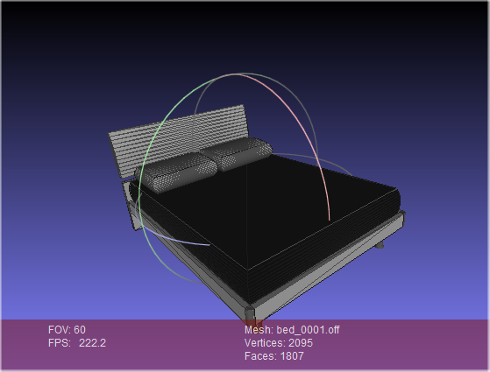
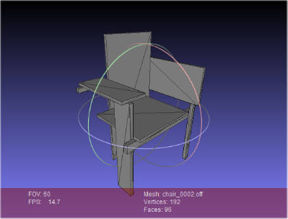
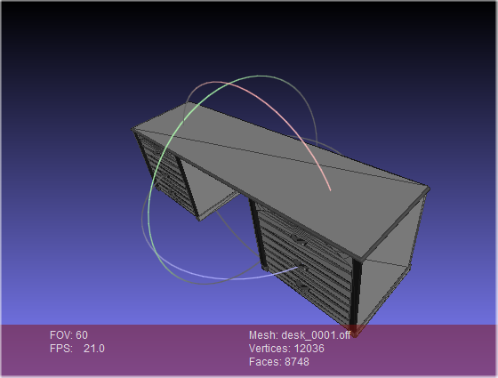
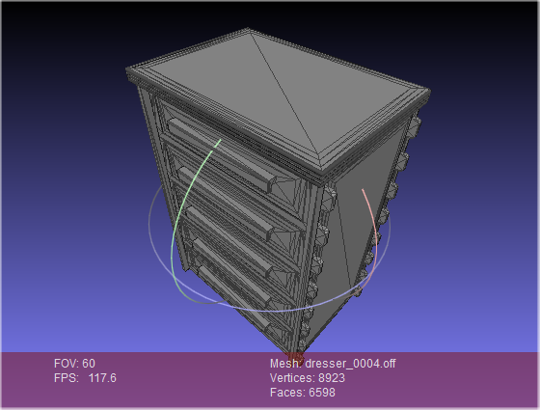
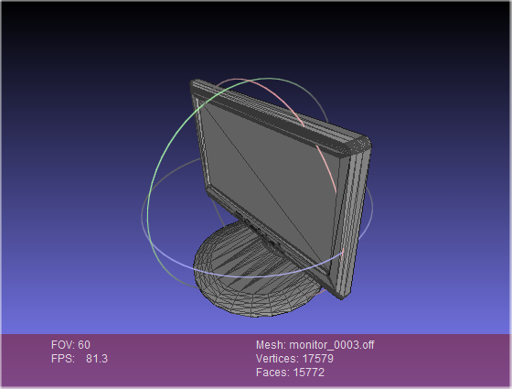
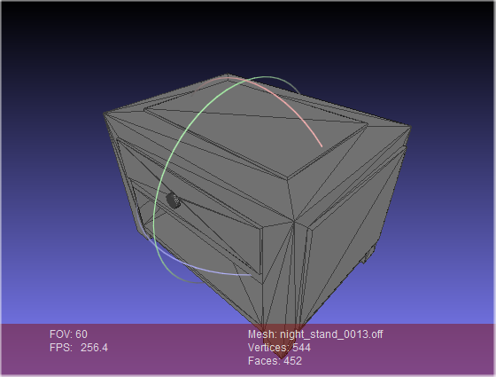
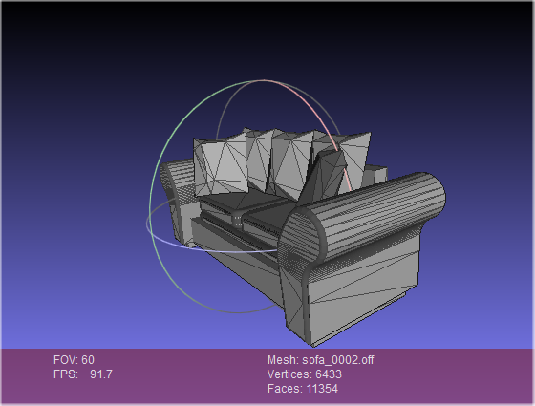
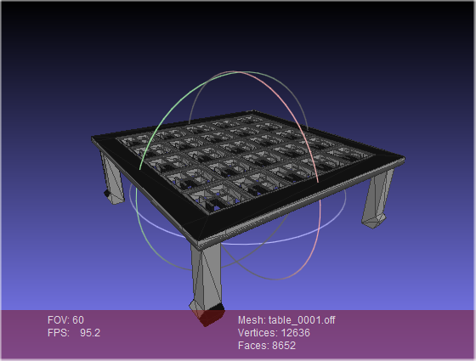
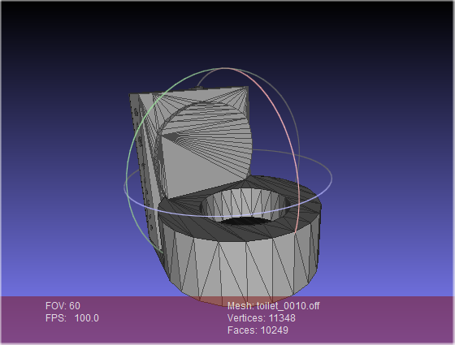
Part 3: Object Recognition
The Princeton ModelNet10 dataset
Contains 3991 training 3D triangular mesh models, 908 testing models.
Classified into 10 categories: bathtub, bed, chair, desk, dresser, monitor, night stand, sofa, table, and toilet

Slide 18
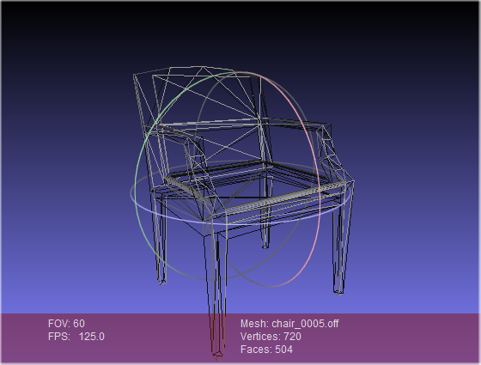
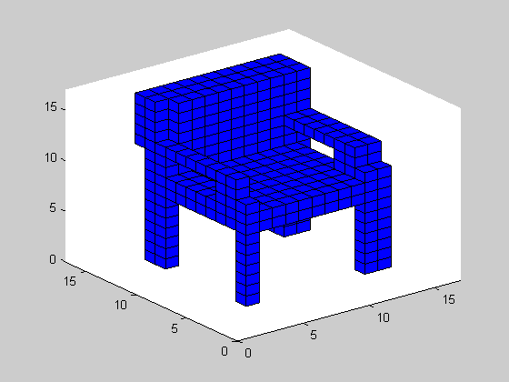
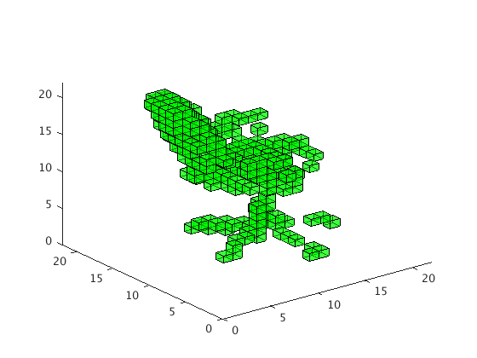
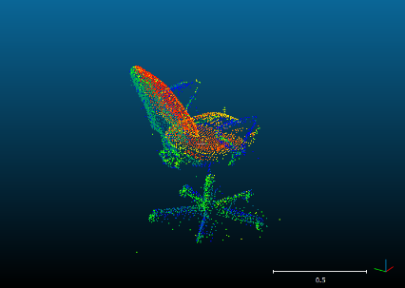
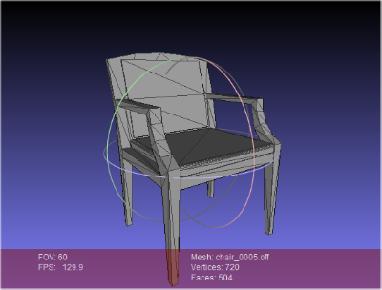
Part 3: Object Recognition
Data normalization
Mesh model to Voxelised data: for training, validation, and testing the deep convolutional neural network
Point cloud data to Voxelised data: use well-trained deep convolutional neural network for classification
Voxelised data
Point cloud data
Triangular mesh model

Slide 19
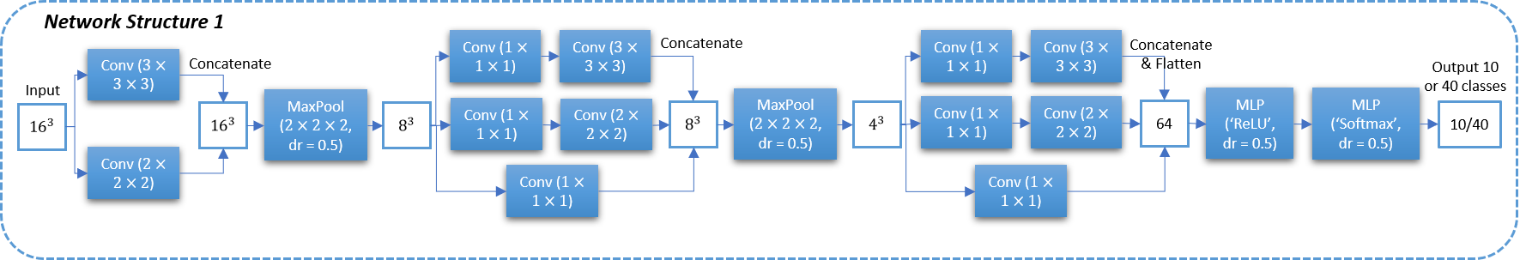
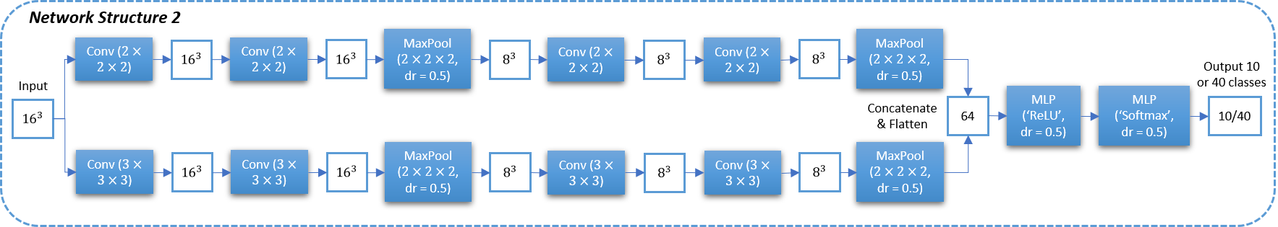
Part 3: Object Recognition
3D convolutional neural networks
Parallelised structure
Final recognition result achieved by aggregating outputs of the two convolutional neural networks

Slide 20
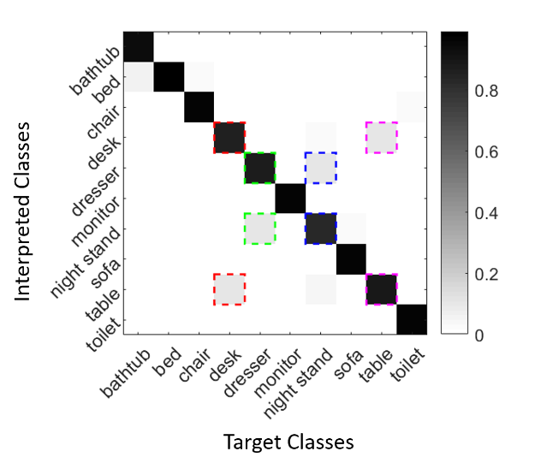
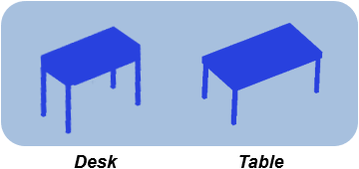
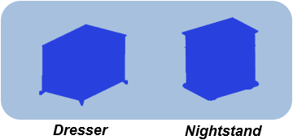
Part 3: Object Recognition
Object recognition results
Overall recognition accuracy of 92.62%
Reduce processing time from days to minutes

Slide 21
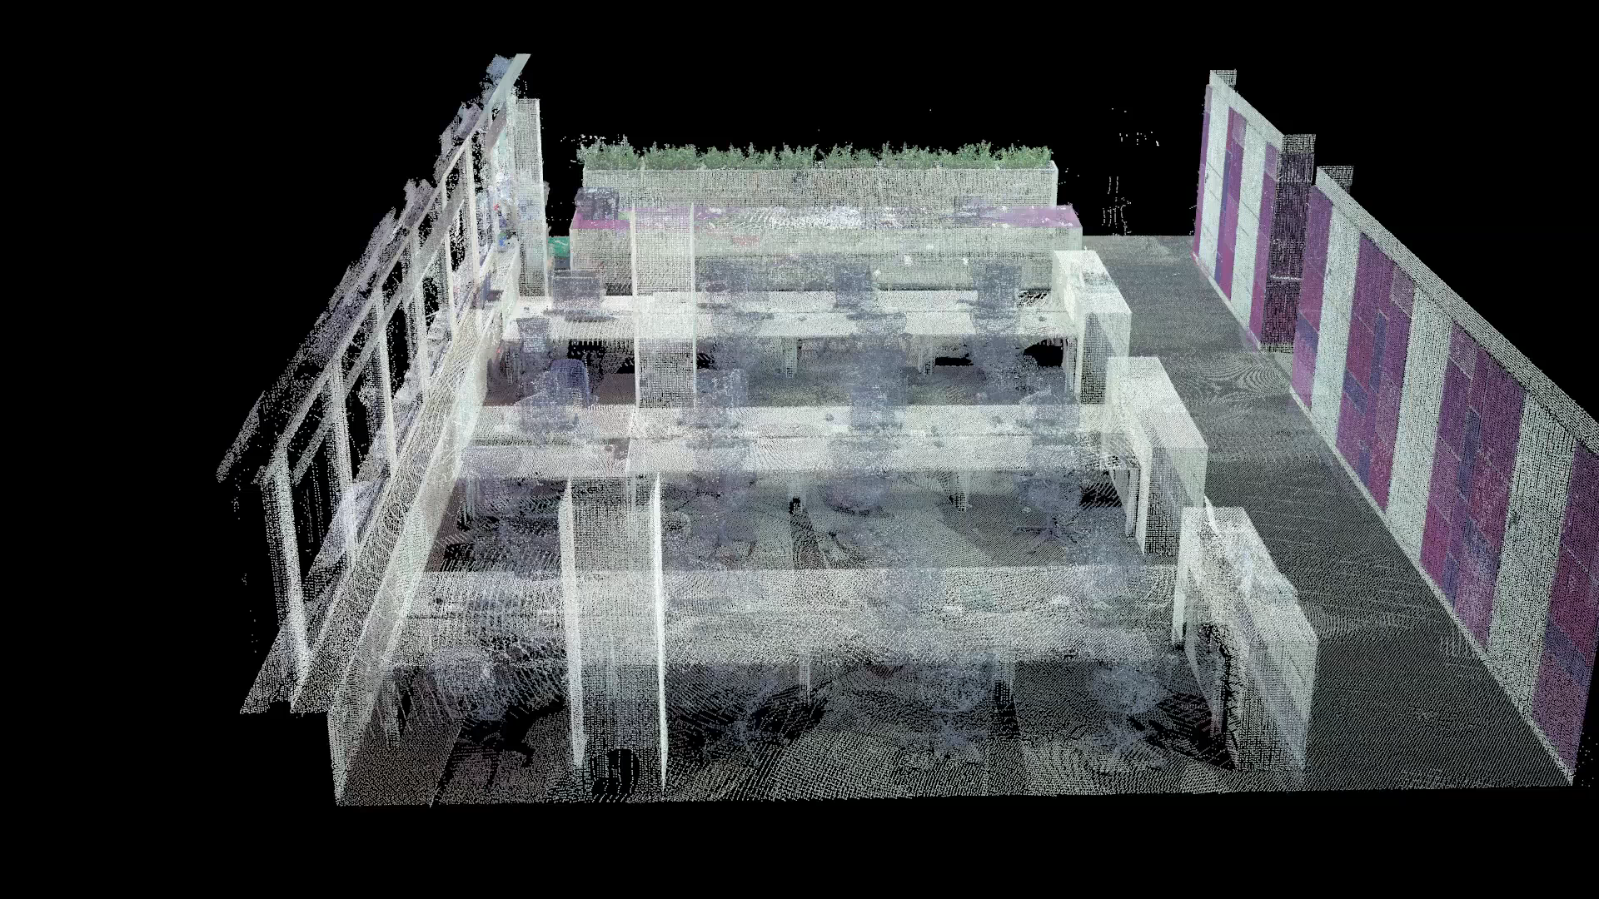
Object segmentation and recognition
Video of chair recognition result of a scanned office interior

